Slide 1
Analog communication Topics name:Tuned Radio-Frequency(TRF) Receiver
Presented To: Presented By:
MD imran Hossain Jabin Tasnim
Assistant professor ID no:11809041
Department of ICT Department of ICT
Comilla University Comilla University

Slide 2
A tuned radio frequency receiver is a type of radio receiver that is composed of one or more tuned radio frequency amplifier stages followed by a detector circuit to extract the audio signal and usually an audio frequency amplifier. The TRF receiver is a simple “logical”receiver. This type of receiver was popular in the 1920s.
INTRODUCTION:

Slide 3
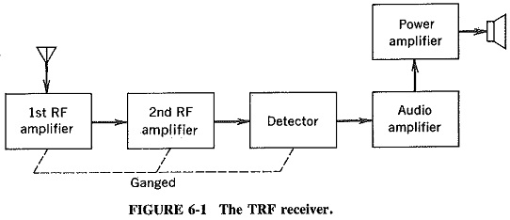
The TRF Receiver:

Slide 4
The classic TRF receivers of the 1920s and 30s usually consisted of three sections: .one or more tuned RF amplifier stages. These amplify the signal of the desired station to a level sufficient to drive the detector, while rejecting all other signals picked up by the antenna. .A detector, which extracts the audio (modulation) signal from the radio carrier signal by rectifying it. .Optionally, but almost always included, one or more audio amplifier stages which increase the power of the audio signal.
How It’s Work?

Slide 5
Although the TRF design has been largely superseded by the superheterodyne receiver, with the advent of semiconductor electronics in the 1960s the design was "resurrected" and used in some simple integrated radio receivers for hobbyist radio projects, kits, and low-end consumer products. One example is the ZN414 TRF radio integrated circuit from Ferranti.
Modern usage:

Slide 6
1.Simplest type of receiver since it does not involve mixing and IF operation. 2.Very much suitable to receive single frequency. 3.TRF receives have good sensitivity. 4.TRF receiver are allow the broadcast frequency 535kHZ to 1640kHZ.
Advantages:

Slide 7
1. Instability of the receiver. 2. Insufficient selectivity at high frequencies and poor adjacent channel rejection. 3.Bandwidth variation over the tuning range.
Disadvantages:

Slide 8


